Slide 1

EDA REPORT FOR DISCOUNT & PRODUCT CATEGORIES ANALYSIS

Slide 2
Business Understanding & Overview
In today’s competitive e-commerce environment, understanding consumer behavior is critical for businesses to optimize their marketing strategies and enhance sales performance. This project explores the impact of discounts and product categories on sales trends. By analyzing consumer trends, businesses can tailor promotional campaigns to maximize revenue and customer satisfaction.
Key objectives include:
Primary Objective: Analyze how discounts and product categories influence sales trends.
Secondary Objectives:
Identify factors influencing customer ratings and reviews.
Detect patterns in customer sentiment from review content.

Slide 3
Understanding the Data
The dataset consists of sales transaction records from an e-commerce platform. It includes the following key attributes:
Customer Information: Age, gender, region.
Sales Data: Product category, purchase amount, discount applied, promo code usage.
Review Data: Ratings, review text.
Temporal Data: Purchase date.
Data cleaning steps:
Removed unnecessary columns like Customer ID.
Standardized column names for consistency.
Categorized continuous variables (e.g., age and purchase amount) into bins for better interpretability.

Slide 4
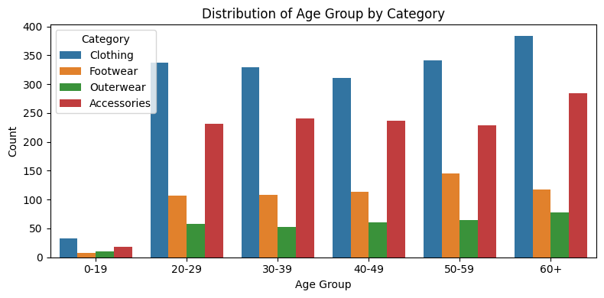
Univariate Analysis
Age Group Analysis
This analysis highlights which age groups contribute the most to each category's sales.
Key Findings:
Age groups 20-29 and 30-39 are the most active buyers across all categories, showing high engagement in Accessories, Clothing, and Footwear.
The 0-19 and 60+ age groups have significantly lower sales compared to other groups.

Slide 5
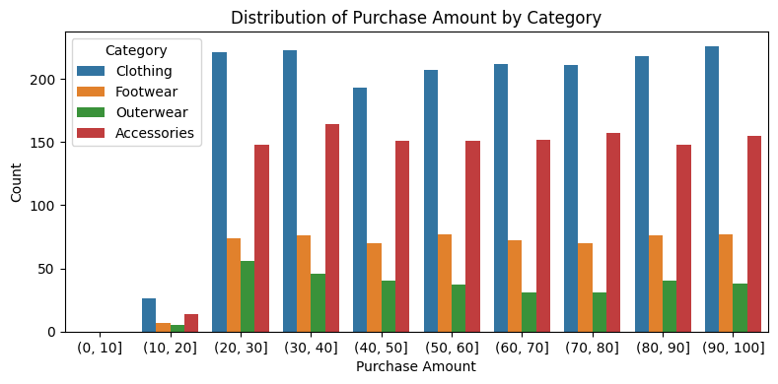
Univariate Analysis
2. Purchase Amount Analysis
Purchase amounts are grouped into ranges, revealing the spending behaviour of customers.
Key Findings:
Most purchases are concentrated in the 20− 30 and 30− 40 ranges across all categories.
Higher purchase ranges ( 90− 100) have fewer sales, indicating that expensive items are less frequently bought.

Slide 6
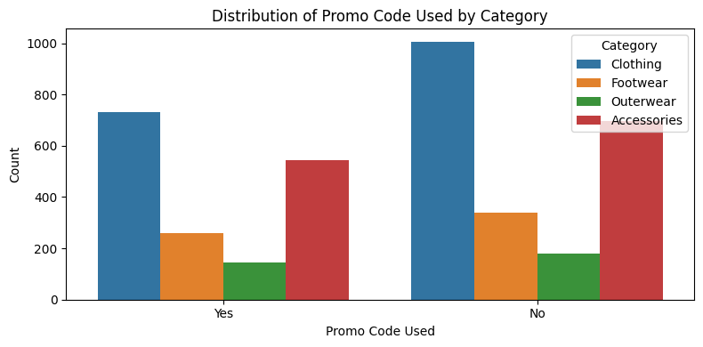
Univariate Analysis
3. Promo Code Usage Analysis
Examines the impact of promo code usage on sales for different categories.
Key Findings:
Promo codes have a noticeable impact on sales, especially for Accessories and Clothing.
Promo codes are less effective in driving sales for Outerwear compared to other categories.

Slide 7

Univariate Analysis
4. Discount Application Analysis
Evaluates the role of discounts in driving category sales.
Key Findings:
Discounts significantly boost sales, especially for Accessories and Clothing.
Categories like Footwear and Outerwear also benefit from discounts but to a lesser extent.

Slide 8
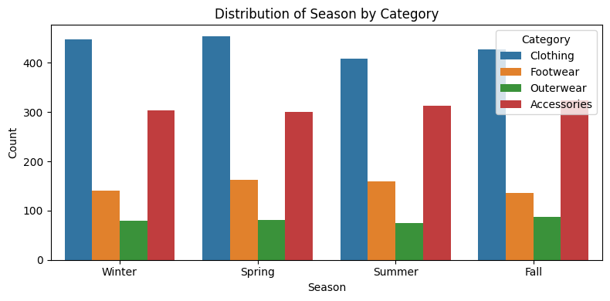
Univariate Analysis
5. Season Analysis
Clothing
Clothing is the most purchased category across all seasons.
The number of purchases is relatively consistent, with slight variations between seasons.
Accessories
Accessories show a significant rise in Spring and Fall compared to Winter and Summer.
They are the second most purchased category overall.
Footwear
Footwear is purchased more in Summer and Spring, suggesting seasonal preferences.
Winter sees the lowest number of footwear purchases.
Outerwear
Outerwear is predominantly purchased in Winter, aligning with colder weather needs.
Purchases drop significantly in other seasons.
This analysis highlights clear seasonal trends, such as increased outerwear purchases in Winter and higher footwear purchases in warmer seasons.

Slide 9
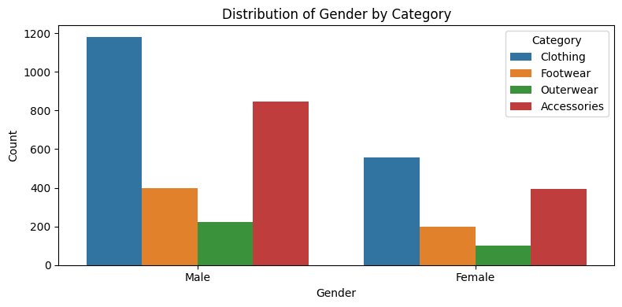
Univariate Analysis
6. Gender Analysis
Accessories
Female: Accessories constitute 31.41% of purchases.
Male: Accessories constitute 31.98% of purchases.
Observation: Both genders have a similar preference for accessories, with slightly higher purchases among males.
Clothing
Female: Clothing constitutes 44.55% of purchases.
Male: Clothing constitutes 44.53% of purchases.
Observation: Clothing is the most purchased category for both genders, with negligible differences in purchase percentages.
Footwear
Female: Footwear constitutes 15.95% of purchases.
Male: Footwear constitutes 15.08% of purchases.
Observation: Females purchase slightly more footwear compared to males.
Outerwear
Female: Outerwear constitutes 8.09% of purchases.
Male: Outerwear constitutes 8.41% of purchases.
Observation: Males purchase slightly more outerwear than females, but the difference is minimal.

Slide 10
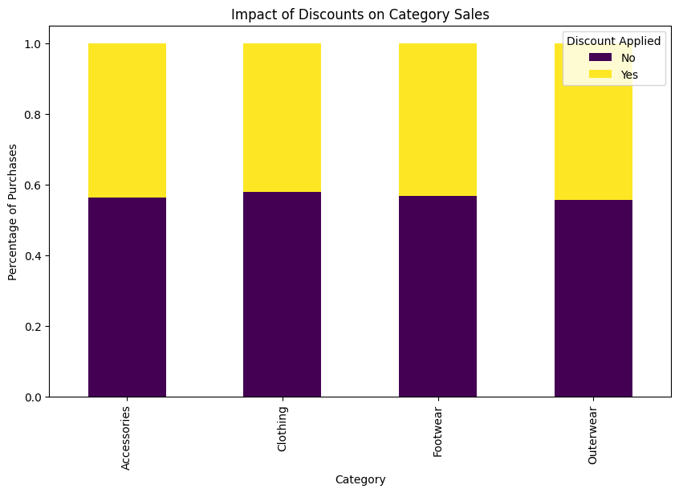
Bivariate Analysis
1. Overall Promo Code Usage
Purchases where promo codes were not used are significantly higher than those where promo codes were applied, across all purchase amount groups.
High Purchase Amounts
In the higher purchase amount groups (e.g., 90− 100), customers without promo codes dominate. This may indicate that customers making larger purchases are less inclined to use promo codes.
Low Purchase Amounts
For lower purchase amount groups (e.g., 10− 20 and 20− 30), promo code usage is relatively lower compared to higher ranges, but the gap between users and non-users is still consistent.
Steady Distribution
The distribution of purchase amounts shows a steady count for non-promo code users across groups, with peaks around the 90− 100 range. In contrast, promo code usage remains more balanced but consistently lower.
Potential Targeting Opportunity
Promo code strategies might benefit from targeting higher purchase amount groups, where non-users are currently dominant, to encourage savings and boost loyalty.

Slide 11
Bivariate Analysis
2. Promo Code Used vs Purchase Amount Grouped
Overall Promo Code Usage
No Promo Code: Purchases without promo codes are significantly higher across all purchase amount groups.
Promo Code Used: Purchases with promo codes are consistently lower in volume compared to non-users.
Observation: The majority of customers do not rely on promo codes, regardless of the purchase amount.
High Purchase Amounts
No Promo Code: Dominates the 90− 100 range with the highest purchase count.Promo Code Used: Shows a decline in usage for higher purchase amounts.
Observation: Customers making larger purchases are less inclined to use promo codes.
Mid Purchase Amounts
No Promo Code: Steady purchase counts in the 40− 70 range, remaining dominant.
Promo Code Used: Relatively consistent usage but remains significantly lower than non-users.
Observation: The gap between promo code users and non-users narrows slightly in this range.
Low Purchase Amounts
No Promo Code: Dominates the 10− 30 range but with lower counts compared to higher ranges.
Promo Code Used: Relatively higher usage compared to other ranges, especially in the 10− 20 group.
Observation: Customers making smaller purchases are more likely to use promo codes to maximize savings.
Distribution Trends
No Promo Code: Shows a steady increase in purchase counts across all groups, peaking in the 90− 100 range.
Promo Code Used: Exhibits a more uniform distribution with no significant peaks.
Observation: Non-promo code users show higher purchase amounts, while promo codes are not driving larger cart sizes.
Potential Targeting Opportunities
High Purchase Amounts: Target promo code campaigns at 70− 100 purchase groups to incentivize savings for larger carts.
Low Purchase Amounts: Offer smaller, easily redeemable promo codes for budget-conscious customers in the 10− 30 range.
General: Educate non-promo code users on the value of discounts to drive customer loyalty and repeat purchases.

Slide 12
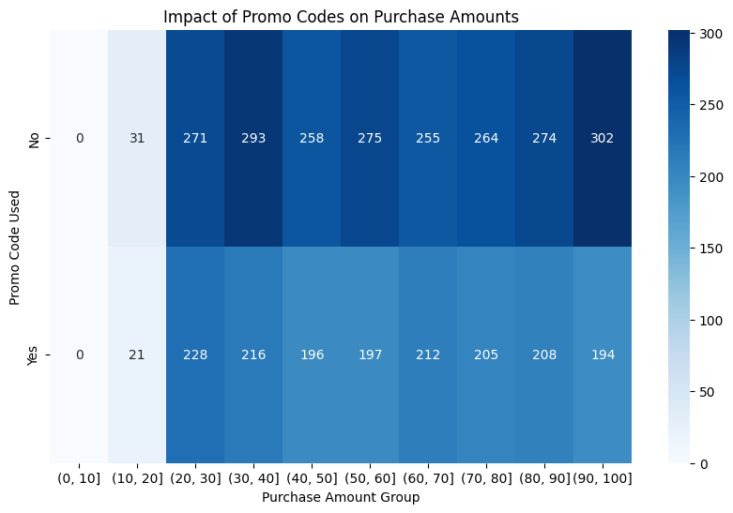
Bivariate Analysis

Slide 13
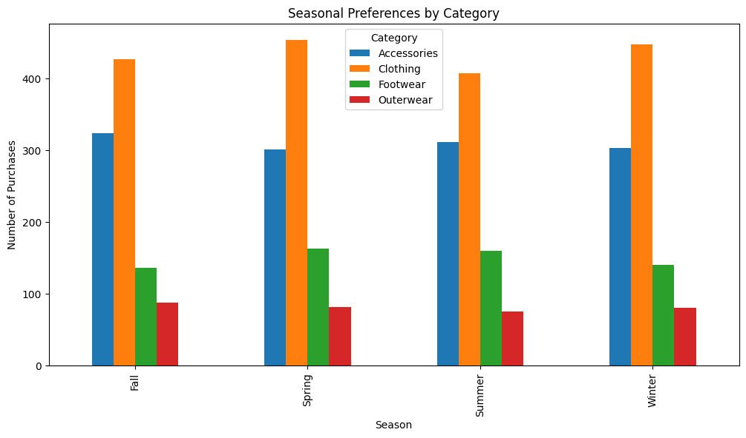
Bivariate Analysis
7. Season vs. Category
Accessories
Female: Accessories constitute 31.41% of purchases.
Male: Accessories constitute 31.98% of purchases.
Observation: Both genders show a similar preference for Accessories, with slightly higher purchases among males.
Clothing
Female: Clothing constitutes 44.55% of purchases.
Male: Clothing constitutes 44.53% of purchases.
Observation: Clothing is the most purchased category for both genders, with negligible differences in purchase percentages.
Footwear
Female: Footwear constitutes 15.95% of purchases.
Male: Footwear constitutes 15.08% of purchases.
Observation: Females purchase slightly more Footwear compared to males.
Outerwear
Female: Outerwear constitutes 8.09% of purchases.
Male: Outerwear constitutes 8.41% of purchases.
Observation: Males purchase slightly more Outerwear than females, though the difference is minimal.
General Insights
Clothing: The dominant category for both genders.
Accessories: The second most popular category for both genders.
Footwear & Outerwear: Less popular overall but show minor gender-based variations.
Purchasing Patterns: Relatively consistent between males and females, with slight differences in categories like Footwear and Outerwear.

Slide 14
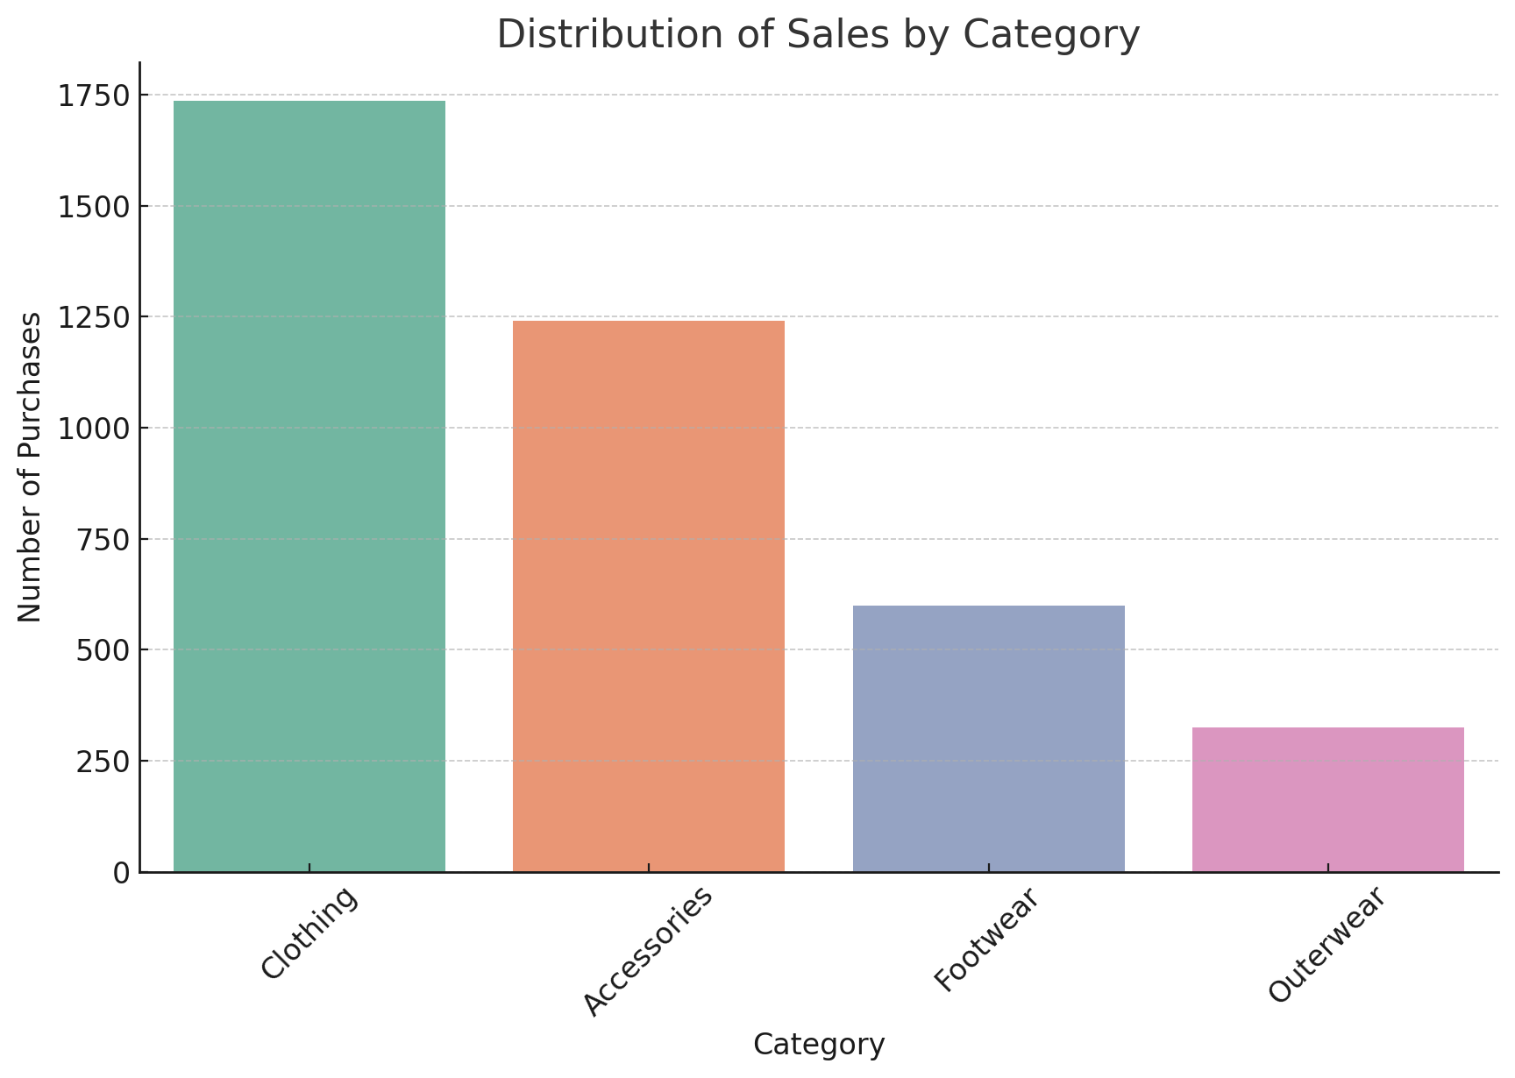
Conclusion
Dominance of Clothing:
Clothing is the most purchased category, accounting for 44.5% of all sales, while Outerwear accounts for only 8.3%, making it the least popular.
Clothing is consistently purchased across all seasons, indicating year-round demand, whereas other categories like Footwear and Outerwear show seasonal variations:
Footwear: Higher sales in Summer and Spring.
Outerwear: Predominantly purchased in Winter.
The age groups 20-29 and 30-39 drive the majority of purchases across all categories, with minimal contributions from the 0-19 and 60+ age groups.

Slide 15
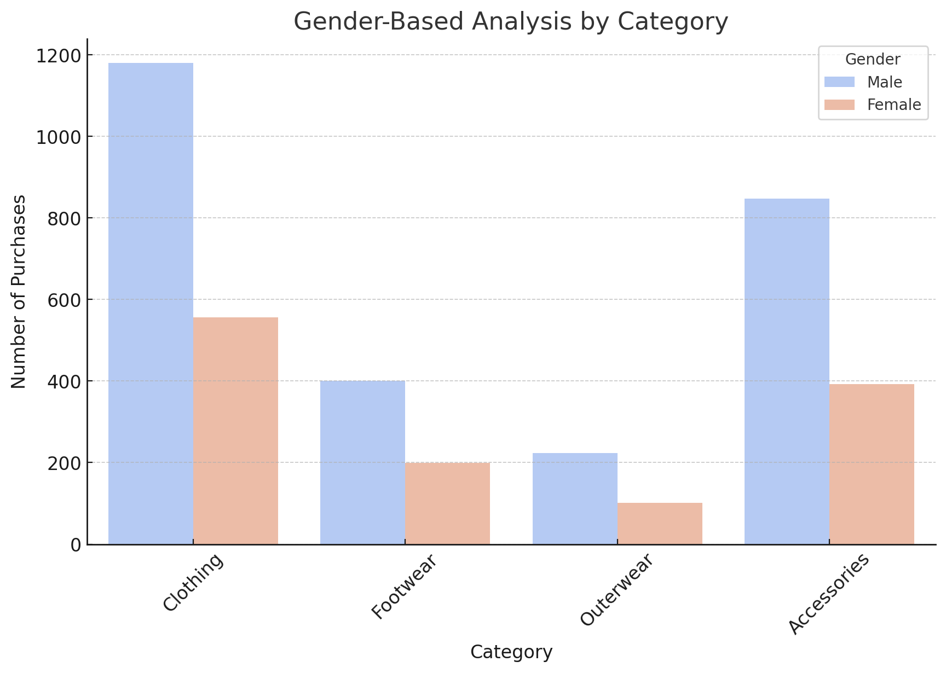
Conclusion
Spending Behavior:
Most customers make purchases in the mid-range price groups (20-30 and 30-40), indicating a preference for moderately priced items.
Higher price ranges (90-100) see significantly fewer sales, suggesting customers are less likely to buy expensive items.
Gender Patterns:
Purchasing behavior between genders is largely consistent, with minor variations:
Both genders show a strong preference for Clothing and Accessories.
Females purchase slightly more Footwear, while males purchase slightly more Outerwear.

Slide 16
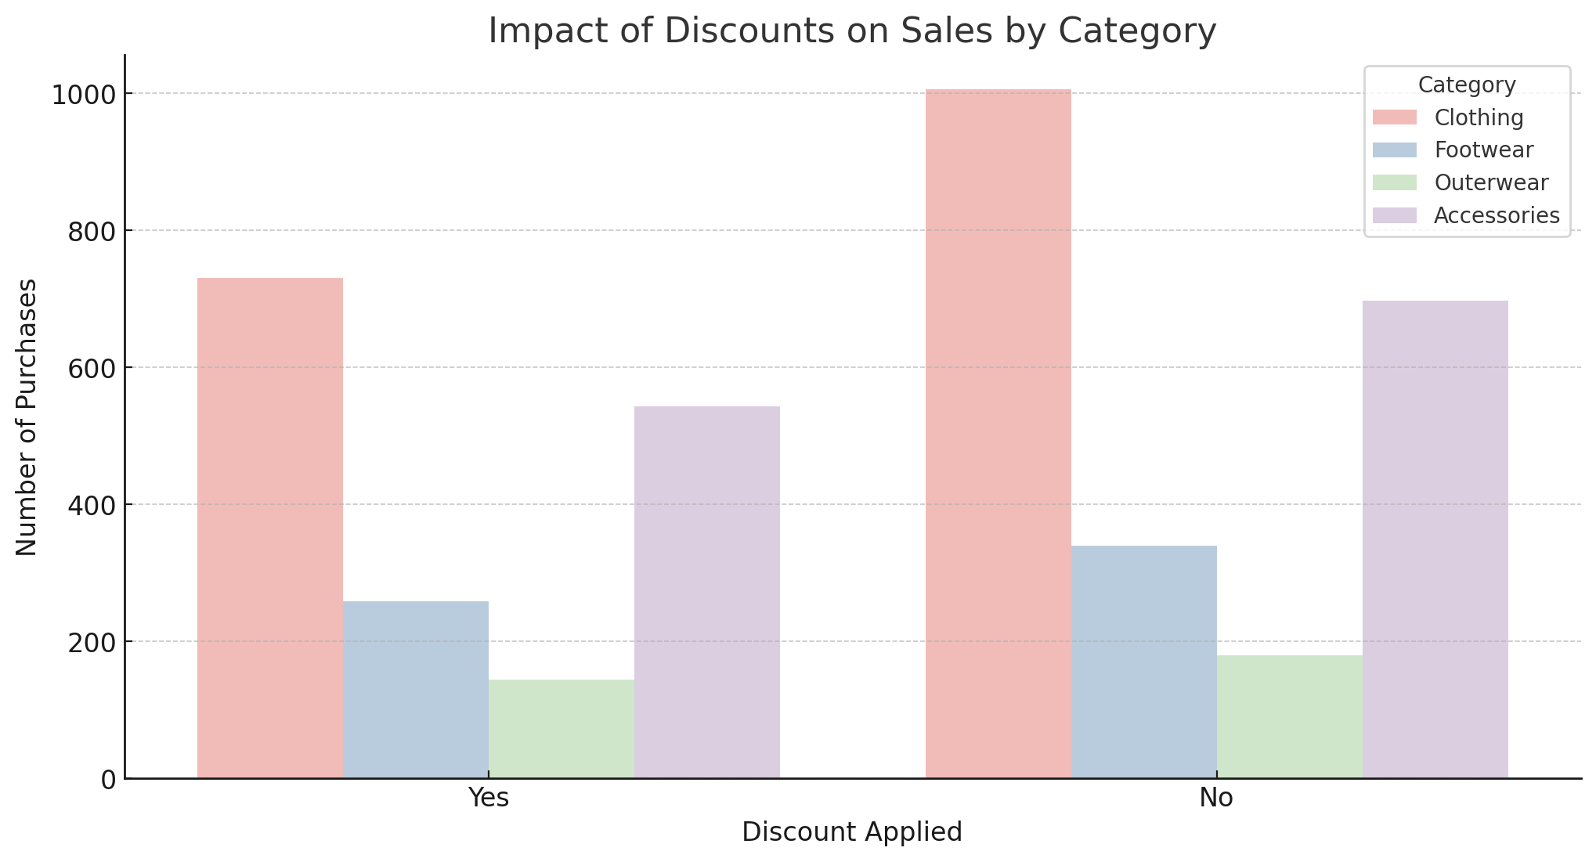
Conclusion
How Discounts Affect Sales Trends?
Impact of Discounts:
Discounts significantly boost sales, particularly in the Accessories and Clothing categories.
Footwear and Outerwear also see increased sales due to discounts, but to a lesser extent.
Promo Code Effectiveness:
Promo codes drive sales more effectively in lower price ranges (10-30) but are underutilized in higher price ranges (90-100).
Promo code usage is more balanced but consistently lower compared to non-promo code purchases across all price groups.
Targeting Opportunity: Promo code strategies could be refined to attract customers in higher purchase ranges (70-100) to encourage savings on larger carts.
Customer Segmentation for Discounts:
Discounts and promo codes should target younger, highly engaged age groups (20-39) and moderately priced products (20-40 price range) to maximize their impact.

Slide 17
Summary of Findings
Clothing is the most significant driver of sales, with Accessories as the second-most purchased category. Seasonal preferences strongly influence sales in categories like Footwear (warmer seasons) and Outerwear (Winter).
Discounts and promo codes play a crucial role in increasing sales, especially for popular categories like Clothing and Accessories. However, they are less effective for high-priced items and categories like Outerwear.
Targeted discount campaigns for specific price ranges and customer segments (e.g., younger age groups, higher purchase amounts) can help optimize sales further.

Slide 18
Recommendations
Seasonal Promotions:
Focus on Outerwear discounts during Winter and Footwear discounts during Spring and Summer.
2. Promo Code Campaigns:
Encourage promo code usage for higher-priced items (70-100 price range) to maximize sales.
Offer smaller, easily redeemable promo codes for budget-conscious customers in lower price ranges (10-30).
Customer Segmentation:
Prioritize marketing efforts for age groups 20-39, as they are the most active buyers.
Maintain consistent engagement for Clothing and Accessories, given their year-round demand.

